Slide 1

JOB PORTAL WITH RESUME PARSING & MATCHING
Course Name :DATABASE SYSTEMS ENGINEERING AND DISTRIBUTED BACKEND DEVELOPMENT
Course Code : 25CS1302E
TEAM Number:12
K.Aasritha sai Lakshmi-2520090006
Komali varnika-2520090010
Divya sree-2520090031
REVIEW 2

Slide 2

INTRODUCTION
  Traditional recruitment processes are slow and mostly manual.
  Recruiters face difficulty in handling large numbers of applications.
  The proposed system automates the recruitment process from application to hiring.
  It automatically analyzes and extracts important information from resumes.
  Candidate skills and qualifications are matched with job requirements.
  The system uses intelligent matching to identify the most suitable candidates.

Slide 3

ABSTRACT
  Recruitment can be time-consuming because recruiters have to manually check many resumes.
  The project Job Portal with Resume Parsing & Matching makes the recruitment process faster and easier.
  Candidates can upload their resumes, and the system automatically extracts skills, education, and experience.
  The system compares the candidate's skills with the job requirements.
  It provides a matching score to help recruiters find suitable candidates.
  MongoDB stores activity and log information.
Overall, the project provides a faster, smarter, and more efficient way to find suitable candidates.

Slide 4

PROBLEM STATEMENT
Recruiters face significant challenges in hiring: they must manually screen large volumes of resumes, which consumes time and effort, often makes it difficult to identify the right candidates, and can lead to inaccurate skill matching. As applications increase, managing the entire hiring process becomes even more complex.
Objectives
  Automate resume parsing to extract candidate details and skills
  Enable accurate skill‑to‑job requirement comparison
  Provide a candidate suitability/matching score for quick shortlisting
  Simplify and accelerate the overall recruitment process

Slide 5
PROPOSED SOLUTION
  Candidate uploads resume
  Resume parsing extracts text & data
  Skills and qualifications identified using NLP
  Job requirements compared with candidate profile
  Matching score generated for suitability
  Recruiter shortlists candidates based on score

Slide 6
METHODOLOGY
[ CANDIDATES & RECRUITERS ]
│
▼ (HTTPS / UI EVENTS)
┌────────────────────────┐
│ FRONTEND: REACT.JS (VITE) │
└───────────┬────────────┘
│
▼(REST API / JSON))
┌─────────────────────────┐
READ / WRITE
│ MAIN BACKEND: NODE.JS / EXPRESS │
◄────────────────────────► [ MONGODB ]
└────────────┬────────────┘
• USER
• JOBS
• APPLICATIONS
│
▼(HTTP / ASYNC DISPATCH)
┌───────────────────────────┐
│ NLP MICROSERVICE: PYTHON / FASTAPI │
└─────────────┬─────────────┘
│
▼
[ MATCHING RESULT & SIMILARITY SCORES ]

Slide 7
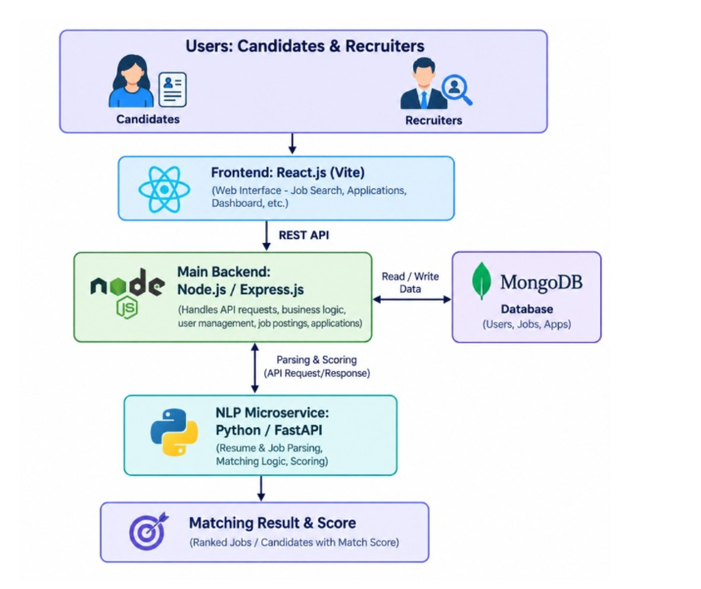
SYSTEM ARCHITECTURE

Slide 8
THANK YOU

